Slide 1


Fraudulent Activity Detection in Credit Card Data Using Data Mining Techniques
Group 6
Yaswanth Reddy Nalamalapu
Hrudhvik Nangineni
Udhay Chityala

Slide 2

Contents
Introduction
Data Source and Description
Data Exploration
Data Mining Task
Models
Performance Evaluation
Results
Conclusion

Slide 3

Introduction
Credit card fraud poses a significant challenge to the financial industry, affecting both businesses and individuals.
To tackle this financial institutions have increasingly employed data mining algorithms for various applications.
They are also trying to predict business failures, analyze marketing trends, and detect fraudulent activities.
This project focuses on identifying effective data mining techniques, such as Random Forests, for detecting fraud in credit card usage and payments.
The aim is to evaluate and compare different data mining techniques based on specific criteria to determine their suitability for fraud detection in credit card transactions.

Slide 4

Data Source and Description
Description: The dataset is a simulated credit card transaction dataset generated using the Sparkov Data Generation tool. The simulation is based on the specified number of customers and merchants using the Python library "faker."
Rows: 1.856 million (556k in test set, 1.30 million in train set)
Columns: 23 features or variables
Sample Variable Names: trans_date_trans_time, cc_num, merchant, category, amt, first, last, gender, street, city, state, zip, lat, long, city_pop, job, dob, trans_num, unix_time, merch_lat, merch_long, is_fraud (Target Class)
Source: Available on Kaggle at Link

Slide 5
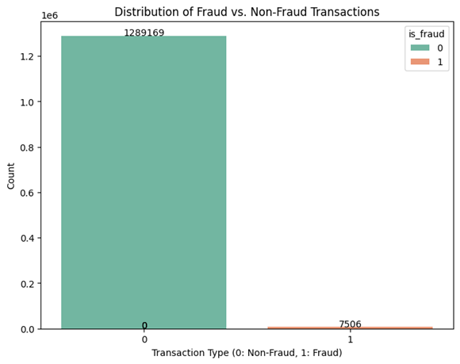
Data Exploration:
The dataset is highly imbalanced, with most transactions being non-fraudulent (0).
There are significantly fewer fraudulent transactions (1) compared to non-fraudulent ones.
This imbalance in the data may need to be addressed through techniques like oversampling or undersampling for effective fraud detection modeling.

Slide 6
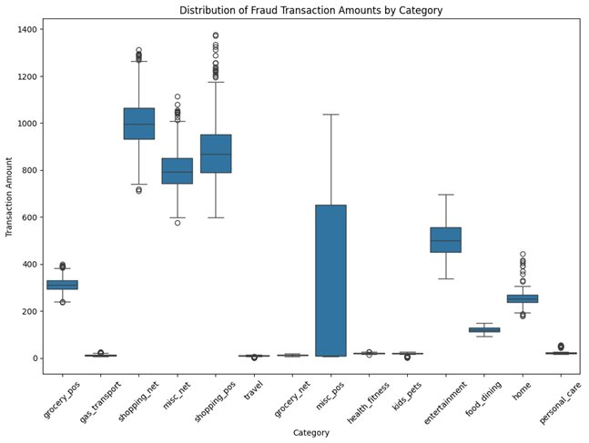
Data Exploration:
Wide range of fraudulent amounts across categories, some with higher variability.
Categories like "personal_care", "health_fitness", "gas_transport", "travel" have lower fraud amounts.
Verification requirements for personal information might contribute to lower fraud in these categories.

Slide 7
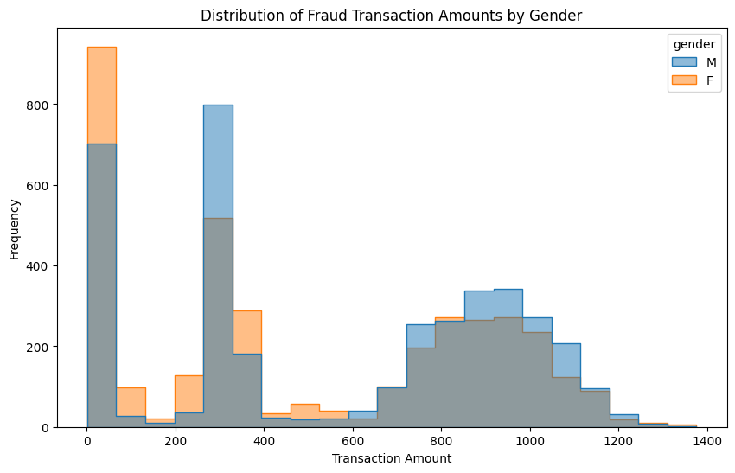
Data Exploration
More male fraud transactions, higher amounts, taller bars on right side indicate this trend.
Both genders skewed right, frequent lower amounts, few high outliers.
Highest fraud amount by male, rightmost bar for males.
Female distribution slightly lower variance, indicating clustered lower fraud amounts.

Slide 8
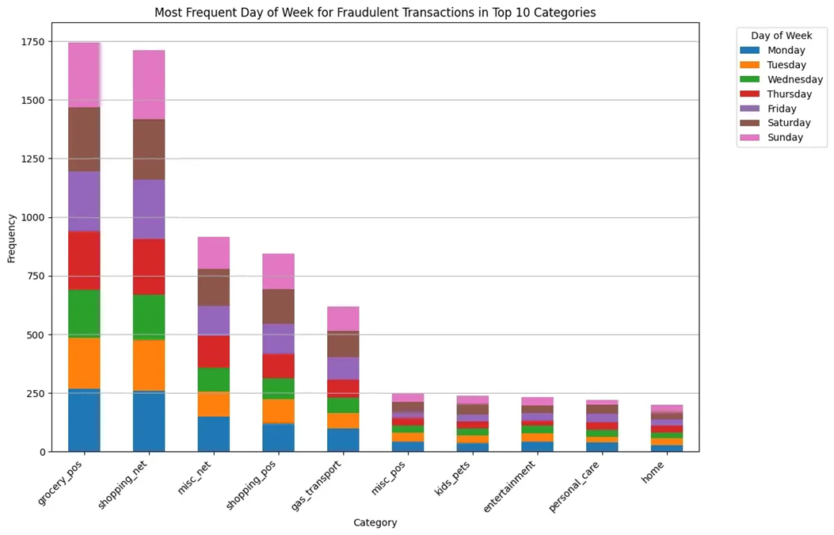
Data Exploration
Most fraudulent transactions occur on Mondays across the top 10 categories.
Categories like "Grocery Stores" and "Shopping Clubs" show a higher frequency of fraudulent transactions on Mondays.
Some categories like "Kids' Apparel" and "Personal Care" exhibit a more uniform distribution across weekdays.

Slide 9
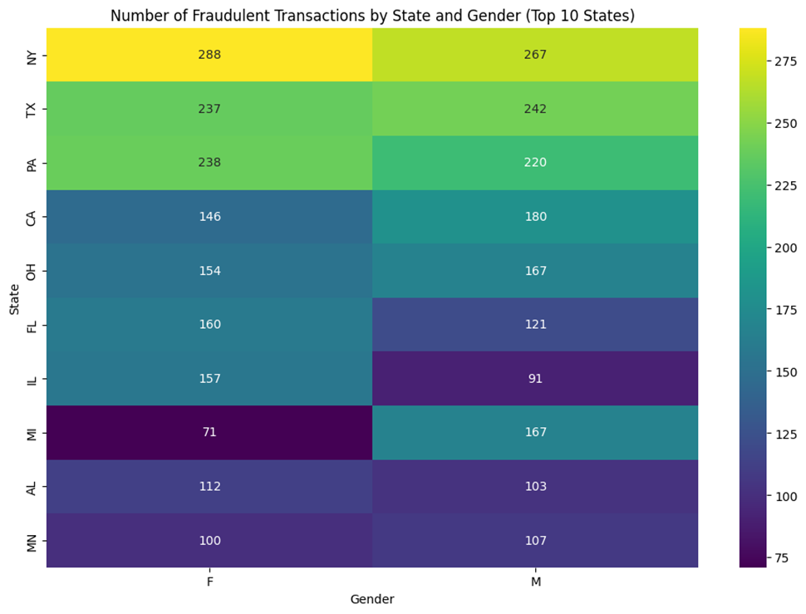
Data Exploration
New York (NY) has the highest number of fraudulent transactions for both genders (male and female).
For most of the top 10 states, the number of fraudulent transactions is higher for males compared to females.
The difference in fraudulent transactions between genders is relatively small for states like Pennsylvania (PA) and Ohio (OH).

Slide 10
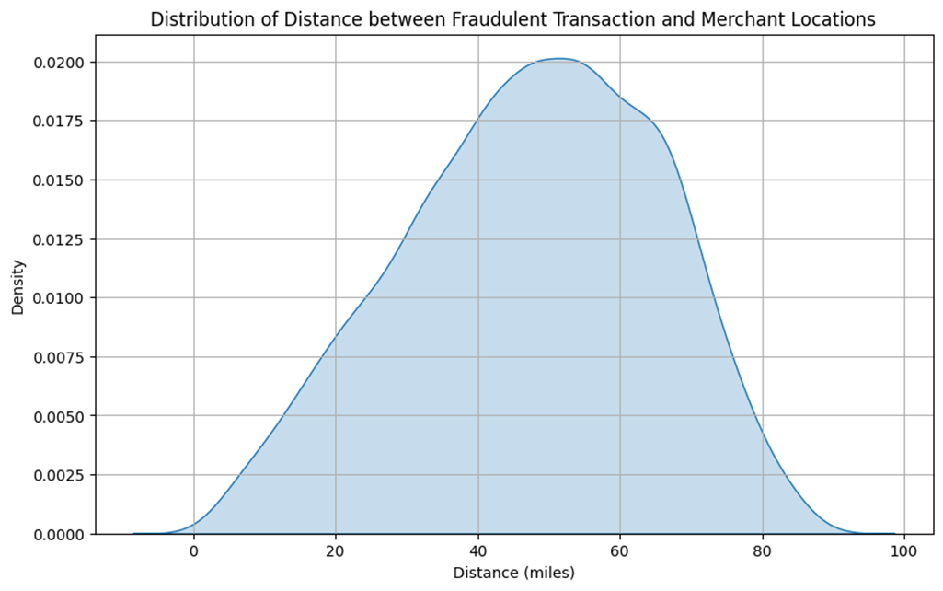
Data Exploration
Distance between fraudulent transaction and merchants follows bell curve, normal distribution.
Highest density at middle range (30-70 miles), indicating common fraudulent activity nearby.
Distribution diminishes off at extremes, fewer frauds at very short or long distances.

Slide 11

Data Mining Task
Data Handling:
No missing values in the dataset, hence preprocessing began without imputation techniques.
Data Preprocessing:
Dropped columns containing private customer data.
Applied label encoding to categorical columns.
Extracted temporal features from 'trans_date_trans_time'.
Handling Imbalanced Data:
Addressed significant class imbalance using a hybrid approach of SMOTE and Random Undersampling.

Slide 12

Data Mining Task
Train Test Split:
Split dataset into training (70%), validation (15%), and test (15%) subsets.
Ensured independent evaluation on unseen data for model generalization.
Model Training and Evaluation:
Implemented various machine learning algorithms (Random Forest, Naive Bayes, XGBoost, MLP).
Trained models on training subset, fine-tuned on validation subset, and tested on independent test subset.
Facilitated thorough comparison for selecting the most suitable model.

Slide 13
Models
Random Forests:
Ensemble learning method that constructs multiple decision trees.
Each tree is built using bootstrapped samples of the training data and random subsets of features.
Aggregates predictions of individual trees to achieve robustness and high accuracy.
Effective in handling high-dimensional data and mitigating overfitting.
Naive Bayes:
Probabilistic classifier based on Bayes theorem with strong independence assumptions between features.
Estimates the probability of each class given a set of input features.
Assumes that the presence of a particular feature in a class is unrelated to the presence of any other feature.

Slide 14
Models
XGBoost (Extreme Gradient Boosting):
Gradient boosting algorithm that sequentially builds an ensemble of decision trees.
Trees are added one at a time, each correcting the errors of the previous ones.
Uses a regularization term in the objective function to control model complexity.
Known for its excellent performance, scalability, and flexibility in various machine learning competitions and real-world applications.
MLP (Multilayer Perceptron):
Type of feedforward artificial neural network with multiple layers of interconnected nodes.
Consists of input, hidden, and output layers.
Employs nonlinear activation functions in the hidden and output layers to learn complex patterns.
Trained using backpropagation algorithm and gradient descent to minimize the difference between predicted and actual outputs.

Slide 15
Performance Evaluation
Accuracy may not the most important value that is to be considered.
1
Precision, Recall, F1-Score, along with AU-ROC & PR-AUC are the most important metrics for evaluation.
2
Precision indicates how many of the predicted fraudulent transactions are fraudulent and high precision means fewer false alarms.
3
Recall indicates how many of the actual fraudulent transactions were correctly predicted and high recall means fewer missed fraudulent transactions.
4
RC-AUC evaluates trade-off between true positive rate and false positive rate.
5
PR-AUC evaluates the precision-recall trade-off, and useful when the false positives are more significant than false negatives
6

Slide 16
Results Before Any Sampling:
Performance of Machine Learning models on Imbalance data
Random Forest and XG Boost consistently showed excellent performance across all metrics, which may be due to overfitting
Naive Bayes did well with Accuracy but lacked in Precision and Recall, maybe due to favoring the majority class.
MLP has struggled with Recall and F1-Score, indicating difficulty in identifying fraud cases.
Models | Accuracy | Precision | Recall | F1-Score | AU-ROC | PR-AUC
Random Forest | 1.0 | 0.96 | 0.8 | 0.86 | 0.8 | 0.76
Naive Bayes | 0.99 | 0.62 | 0.73 | 0.65 | 0.73 | 0.35
XG Boost | 1.0 | 0.92 | 0.82 | 0.85 | 0.82 | 0.74
MLP | 1.0 | 0.83 | 0.5 | 0.5 | 0.5 | 0.34

Slide 17
Results After Using Sampling Methods:
Performance of Machine Learning models After balancing Imbalance data
Method | Model | Accuracy | Precision | Recall | F1-Score | AU-ROC | PR-AUC
Oversampling 20% Undersampling 20% | Random Forest | 0.95 | 0.97 | 0.85 | 0.90 | 0.85 | 0.87
 | Naive Bayes | 0.91 | 0.88 | 0.75 | 0.80 | 0.75 | 0.73
 | XG Boost | 0.96 | 0.96 | 0.89 | 0.92 | 0.89 | 0.90
 | MLP | 0.94 | 0.92 | 0.85 | 0.88 | 0.83 | 0.84
Oversampling 20% Undersampling 30% | Random Forest | 0.93 | 0.96 | 0.86 | 0.90 | 0.86 | 0.89
 | Naive Bayes | 0.88 | 0.88 | 0.76 | 0.80 | 0.76 | 0.77
 | XG Boost | 0.95 | 0.96 | 0.90 | 0.93 | 0.90 | 0.91
 | MLP | 0.91 | 0.92 | 0.82 | 0.86 | 0.82 | 0.84
Oversampling 20% Undersampling 40% | Random Forest | 0.92 | 0.95 | 0.87 | 0.90 | 0.87 | 0.90
 | Naive Bayes | 0.86 | 0.88 | 0.76 | 0.79 | 0.76 | 0.80
 | XG Boost | 0.94 | 0.95 | 0.91 | 0.93 | 0.91 | 0.92
 | MLP | 0.90 | 0.91 | 0.85 | 0.87 | 0.85 | 0.86

Slide 18
Results After Using Sampling Methods:
20% Oversampling and 20% Undersampling:
Random Forest: Maintained high performance with minor drops in Accuracy and Precision, improved Recall.
Naive Bayes: Showed improvement in most metrics but slight decrease in Precision.
XG Boost: Highest overall performance, particularly in Recall and F1-Score. MLP: Improved performance across most metrics.
20% Oversampling and 30% Undersampling:
Random Forest: Slight decrease in accuracy and precision, increase in recall.
Naive Bayes & XG Boost: Similar trend with all metrics, especially Recall.
MLP: Maintained strong performance but minor reductions in Recall and F1-Score.
20% Oversampling and 40% Undersampling:
Every model experienced slight decrease in accuracy and precision but increase in recall.
Generating highest important metrics (AU-ROC, PR-AUC).

Slide 19
Conclusion
Generally good model performance observed across various sampling depths.
Accuracy improves with deeper representation of fraud cases in the sample which may not be always desirable.
Higher errors noted with decreasing PRAUC and AU-ROC scores with deeper representation of fraud cases.
Random Forests & XG Boost are our best performing Models.
These methods are considered ensemble decision tree algorithms, so this type of problem performs well for the algorithms based on decision trees.

Slide 20


